Slide 1

Final Project, Part 1: Lightning Talk
By Anneil Basnandan

Slide 2

Predict Amount to Spend on Paid Search
Background: Paid search is very costly; how much should be spent on paid search to achieve the most number of reservations (i.e., conversions)
Factors: time period (month), amount spent on paid search, number of reservations
Hypothesis: Budgeting $40,000 per month is the optimal amount to spend on Paid Search
Explore: Are other forms of search more profitable that paid search? Does the time of the year matter (i.e., should the data be de-seasonalized?) Should the amount spent vary from month to month?

Slide 3

Which Discount is Most Effective?
Background: Manhattan Mini Storage gives out different discounts throughout the year; which discount is most effective in terms of length of stay and profit?
Factors: date, discount type, length of stay, rent amount, season, size of room
Hypothesis: The more the discount is, the longer the length of stay (i.e., rent amount and length of stay are inversely proportional).
Explore: Is there a discount that increases both profit and length of stay? Should prices be raised and then a discount applied to “disguise” a deal?

Slide 4
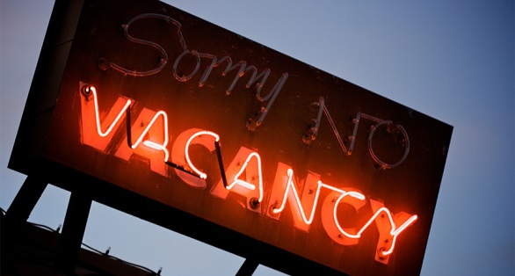
Predicting Length of Vacancy
Background: Extra Large rooms are vacant for a very long time; How long do we expect the room to be vacant before it is rented? If we reduce the price of the room, how does that affect the vacancy time period?
Factors: Size of room, rent, location, season, length of time vacant
Hypothesis: Extra Large rooms are only vacant for a few months before someone is willing to pay the price of the room. We should keep the price the same and wait…more profit to be made.
Explore: A reduction in the price by “X” will decrease the vacancy period by “Y”

